Slide 3
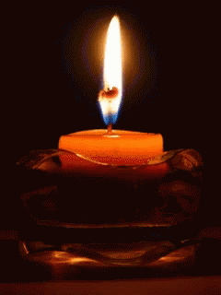
Lighting the Christ Candle

Slide 5
The Lord be with you
And also with you

Slide 6
Let us
pass the peace

Slide 8
1 Have mercy on me, O God, according to Your unfailing love; according to Your great compassion blot out my transgressions.
2 Wash away all my iniquity and cleanse me from my sin.

Slide 9
3 For I know my transgressions, and my sin is always before me.
4 Against You, You only, have I sinned and done what is evil in Your sight, so that you are proved right when You speak and justified when You judge.

Slide 10
5 Surely I was sinful at birth, sinful from the time
my mother conceived me.
6 Surely You desire truth
in the inner parts; You teach me wisdom
in the inmost place.

Slide 11
7 Cleanse me with hyssop,
and I will be clean; wash me, and I will be whiter than snow.
8 Let me hear joy and gladness; let the bones You have crushed rejoice.

Slide 12
9 Hide Your face from my sins and blot out all my iniquity.
10 Create in me a pure heart, O God, and renew a steadfast spirit within me.

Slide 13
11 Do not cast me from Your presence or take Your Holy Spirit from me.
12 Restore to me the joy of Your salvation and grant me a willing spirit, to sustain me.
Amen

Slide 15
For the beauty of the earth, for the beauty of the skies, for the love which from our birth over and around us lies, Refrain
Christ our God, to You we raise this our sacrifice of praise.
1/6

Slide 16
For the beauty of each hour of the day and of the night, hill and vale, and tree and flower, sun and moon, and stars of light,
Refrain
Christ our God, to You we raise this our sacrifice of praise.
2/6

Slide 17
For the joy of ear and eye, for the heart and mind's delight, for the mystic harmony linking sense to sound and sight,
Refrain
Christ our God, to You we raise this our sacrifice of praise.
3/6

Slide 18
For the joy of human love, brother, sister, parent, child, friends on earth, and friends above, for all gentle thoughts and mild,
Refrain
Christ our God, to You we raise this our sacrifice of praise.
4/6

Slide 19
For each perfect gift divine to our race so freely given, graces all of Your design, flowers of earth and buds of heaven,
Refrain
Christ our God, to You we raise this our sacrifice of praise.
5/6

Slide 20
For the church that evermore lifting holy hands above, offers up on every shore the pure sacrifice of love,
Refrain
Christ our God, to You we raise this our sacrifice of praise.
6/6

Slide 23
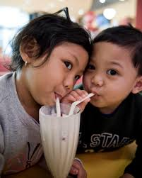

Slide 24
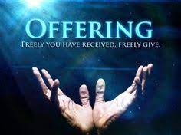

Slide 26
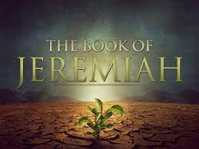

Slide 27
³¹ “The days are coming,” declares the Lord, “when I will make a new covenant with the people of Israel and with the people of Judah.

Slide 28
³² It will not be like the covenant I made with their ancestors when I took them by the hand to lead them out of Egypt, because they broke my covenant, though I was a husband to them,” declares the Lord.

Slide 29
³³ “This is the covenant
I will make with the people of Israel after that time,” declares the Lord. “I will put my law in their minds and write it on their hearts. I will be their God, and they will be my people.

Slide 30
³⁴ No longer will they teach their neighbour, or say to one another,
‘Know the Lord,’ because they will all know me, from the least of them to the greatest,” declares the Lord. “For I will forgive their wickedness and will remember their sins no more.”

Slide 33
²⁰ Now there were some Greeks among those who went up to worship at the festival.
²¹ They came to Philip, who was from Bethsaida in Galilee, with a request. “Sir,” they said, “we would like to see Jesus.” ²² Philip went to tell Andrew;
Andrew and Philip in turn told Jesus.
²³ Jesus replied, “The hour has come for the Son of Man to be glorified.

Slide 34
²⁴ Very truly I tell you, unless a kernel of wheat falls to the ground and dies, it remains only a single seed. But if it dies, it produces many seeds.
²⁵ Anyone who loves their life will lose it, while anyone who hates their life in this world will keep it for eternal life.
²⁶ Whoever serves me must follow me; and where I am, my servant also will be. My Father will honour the one who serves me.

Slide 35
²⁷ “Now my soul is troubled, and what shall I say? ‘Father, save me from this hour’? No, it was for this very reason I came to this hour.
²⁸ Father, glorify your name!”
Then a voice came from heaven,
“I have glorified it, and will glorify it again.”

Slide 36
²⁹ The crowd that was there and heard it said it had thundered; others said an angel had spoken to him.
³⁰ Jesus said, “This voice was for your benefit, not mine.
³¹ Now is the time for judgment on this world;
now the prince of this world will be driven out.
³² And I, when I am lifted up from the earth, will draw all people to myself.” ³³ He said this to show the kind of death he was going to die.

Slide 38
Christ is our cornerstone, on Him alone we build; with His true saints alone the courts of heaven are filled: on His great love our hopes we place of present grace and joys above.
1/4

Slide 39
O then with hymns of praise these hallowed courts shall ring; our voices we will raise the Three in One to sing; and thus proclaim in joyful song
both loud and long that glorious Name.
2/4

Slide 40
Here, gracious Lord, You do
for evermore draw nigh; accept each faithful vow, and mark each suppliant sigh: in copious shower on all who pray, each holy day Your blessings pour.
3/4

Slide 41
Here may we gain from heaven the grace which we implore; and may that grace, once given, be with us evermore, until that day when all the blest to endless rest are called away.
4/4
Words: Latin, eighth century; trans. John Chandler, 1837

Slide 43
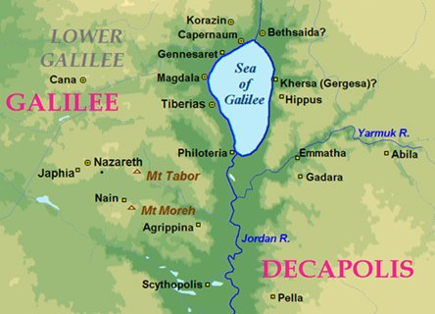

Slide 44
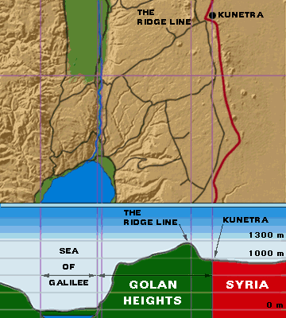

Slide 45
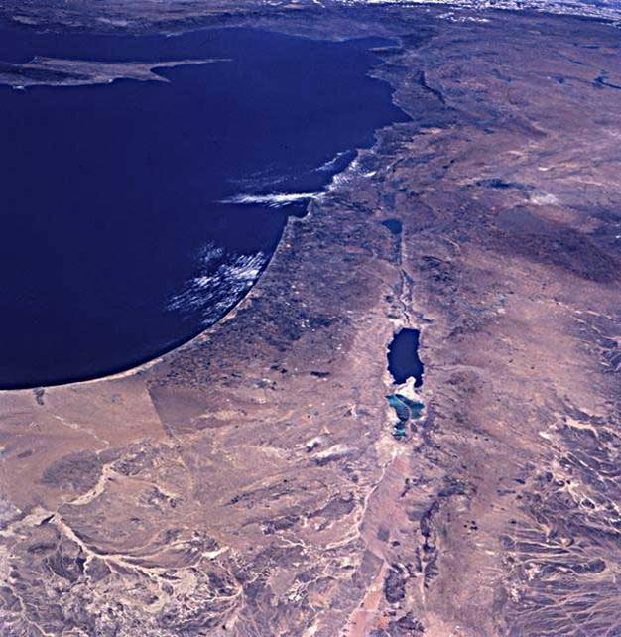

Slide 46
²⁰ Now there were some Greeks, Jewish proselytes, among those who went UP to worship at the festival. ²¹ They came to Philip,
a Greek named disciple, who was from Bethsaida in Galilee, with a request, they may have recognised him being from their area. “Sir,” they said, “we would like to see Jesus.” popular with ppl, not Pharisees.

Slide 47
²² Philip went to tell Andrew; Andrew and Philip in turn told Jesus.²³ Jesus replied, “The hour has come for the Son of Man to be glorified, momentarily at transfiguration, soon forever. Like Peter and his timing on the mount. (some time later …..)
²⁴ Truly I tell you, unless a kernel of wheat falls to the ground and dies, it remains only a single seed. But if it dies, it produces many seeds.

Slide 48
²⁵ Anyone who loves their life, for themselves, will lose it, while anyone who hates, shares,
their life in this world will keep it for eternal life.
²⁶ Whoever SERVES ME must FOLLOW ME; and WHERE I AM, my servant also WILL BE.
My Father will honour the one who serves me.
The road to glory is servanthood.

Slide 49
We need to pause in reading in order to get the feel of the context, the emotion, because to let it all run together would remove the timing and the importance of what is being said.

Slide 50
²⁷ “Now my soul is troubled, and what shall I say? ‘Father, save me from this hour’?
Gethsemane is to come….
NO, it was for this very reason I came to this hour.

Slide 51
²⁸ Father, glorify your name!”
Then a voice came from heaven,
“I have glorified it, and will glorify it again.”
²⁹ The crowd that was there and heard it said it had thundered; others said an angel had spoken to him. We hear individually, not the same. Do we become Christians all the same way??

Slide 52
³⁰ Jesus said, “This voice was for your benefit, not mine. ³¹ Now is the time for judgment on this world; now the prince of this world will be driven out. ³² And I, when I am lifted up from the earth, will draw all people to myself.” like a beacon.

Slide 54
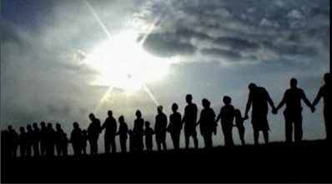
Prayers of the People

Slide 55
Our Father in heaven,
hallowed be Your name,
Your kingdom come,
Your will be done
On earth as in heaven.
Give us today our daily bread.

Slide 56
And forgive us our sins,
As we forgive those
who sin against us.
Save us from the time of trial,
And deliver us from evil.
For the kingdom, the power
and the glory are Yours,
Now and forever. Amen.

Slide 58
At the Name of Jesus
Every knee shall bow,
Every tongue confess Him
King of glory now;
'Tis the Father's pleasure
We should call Him Lord,
Who from the beginning
Was the mighty Word.
1/5

Slide 59
Humbled for a season,
To receive a Name
From the lips of sinners,
Unto whom He came,
Faithfully He bore it
Spotless to the last,
Brought it back victorious,
When from death He passed;
2/5

Slide 60
Name him, brothers, name Him,
With love as strong as death,
But with awe and wonder
And with bated breath;
He is God the Saviour,
He is Christ the Lord,
Ever to be worshipped,
Trusted, and adored.
3/5

Slide 61
In your hearts enthrone Him;
There let Him subdue
All that is not holy,
All that is not true;
Crown Him as your Captain
In temptation's hour;
Let His will enfold you
In its light and power.
4/5

Slide 62
Brothers, this Lord Jesus
Shall return again,
With His Father's glory
With His angel train;
For all wreaths of empire
Meet upon His brow,
And our hearts confess Him
King of glory now.
5/5

Slide 64
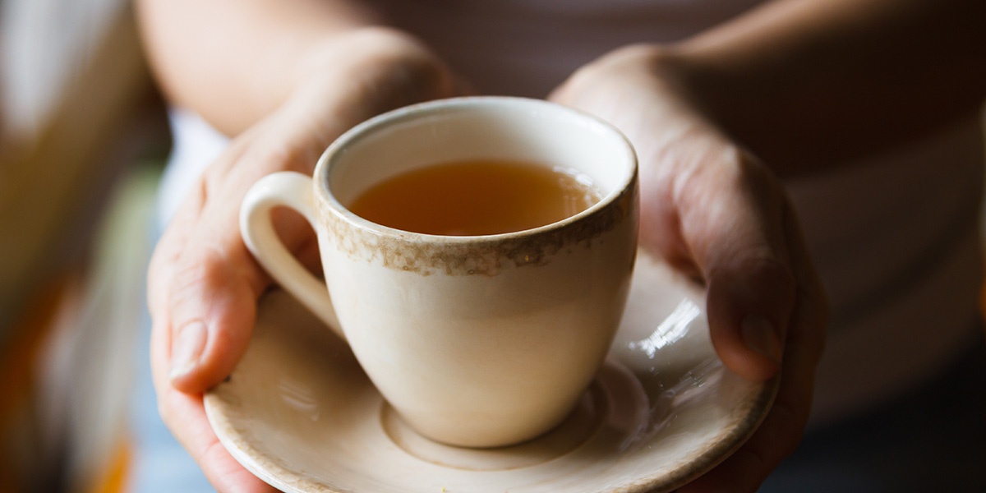
Morning
Good
Have a Great week

Slide 65
